Slide 1




GIOMS
Grocery Inventory & Order Management System
Samuel Orellana
Tasfia Hossain
Yudava Roopnarine
Ivan Jimenez
Rakib Rary
Matthew Murillo
Kevin Ren

Slide 2




Purpose
GIOMS embracing its namesake is a grocery inventory and order management system designed to be used by grocery warehouses. The purpose of GIOMS is to provide Whole Foods Market Inc. with a much faster and more accurate inventory and order management system that will help alleviate discrepancies warehouses experience such as such as not providing Whole Food stores with accurate delivery times, warehouse inventory quantities not reflecting true-to-life inventory, and order quantity errors which result in stores receiving more or less products than they ordered. GIOMS does this by having faster read/write access than other competitive software allowing Whole Foods warehouses to quickly address any data inconsistency they find.

Slide 3
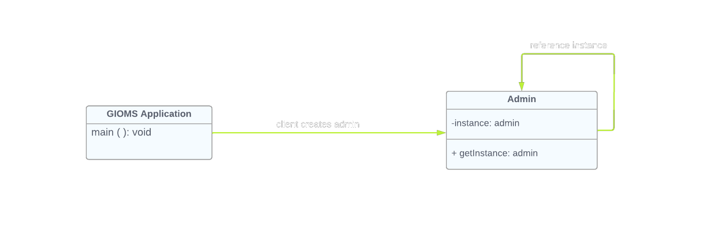
Singleton Pattern
🧍‍♂️
🧍‍♂️
Samuel Orellana
GIOMS Application: upon initial startup, software requests admin instantiation
Admin: admin is instantiated, any admin reference will refer to the one previously made instance
The purpose of a singleton pattern is to restrict the instantiation of a class to one single instance that will serve as a global variable. This aids in controlling access to restricted resources.

Slide 4
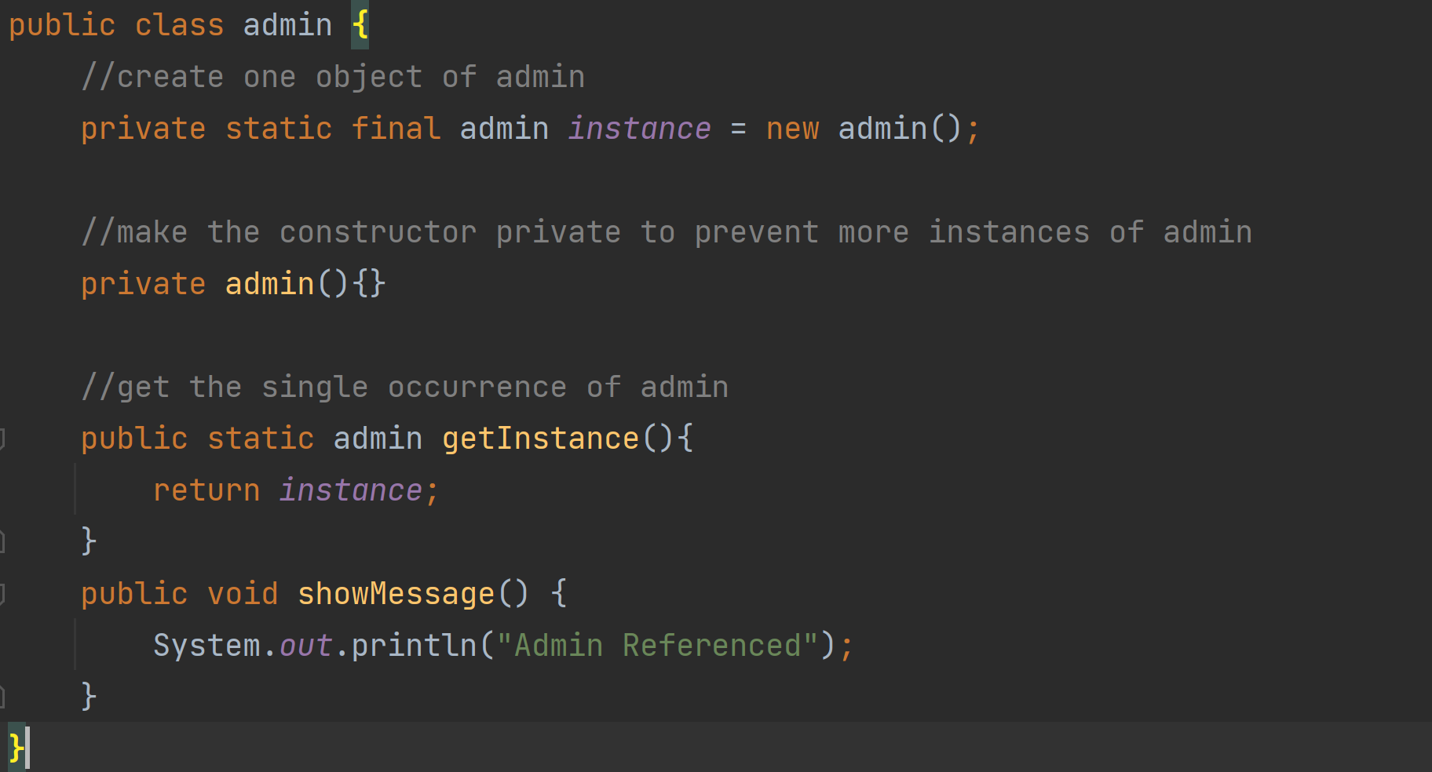
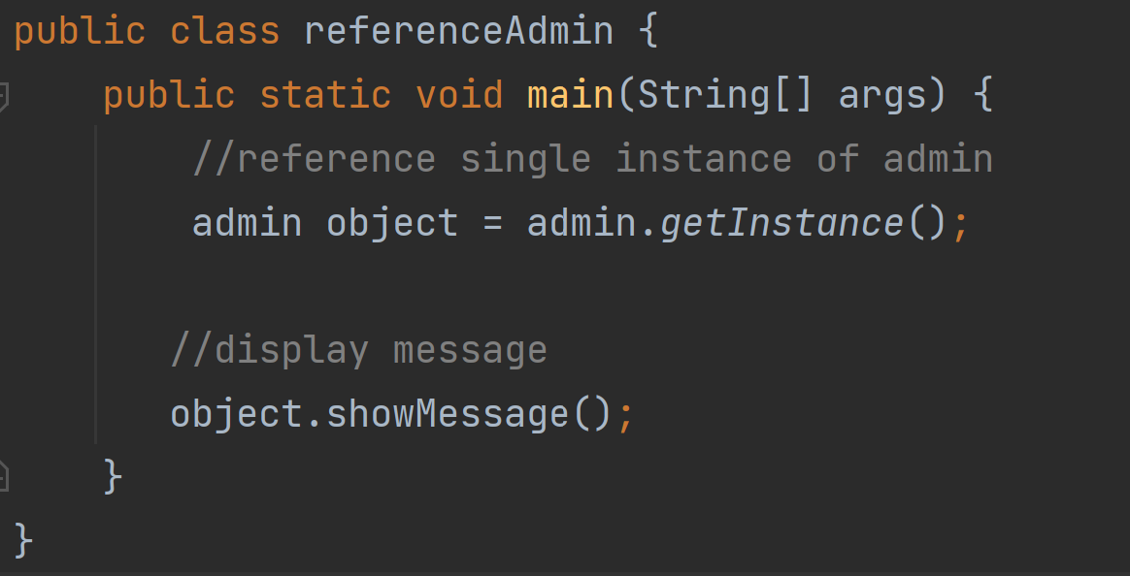
Instantiation
Samuel Orellana
Reference

Slide 5

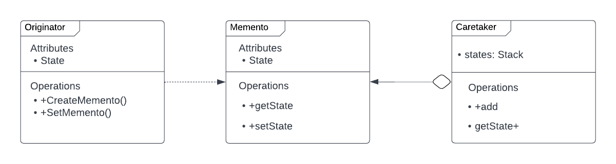
Memento Pattern
By: Tasfia Hossain
Originator Class: the object for which the state is to be saved.
Memento Class: the object that is going to maintain the state of originator.
Caretaker Class: the object that keeps track of multiple memento (save points)
Memento pattern is used to restore state of an object to a previous state. As your application is progressing, you may want to save checkpoints in your application and restore back to those checkpoints later. In this project, I implemented this design pattern to allow employees to have the option to submit how much inventory of each product is being shipped out or brought in, and given they made a mistake, have the option to undo it.

Slide 6
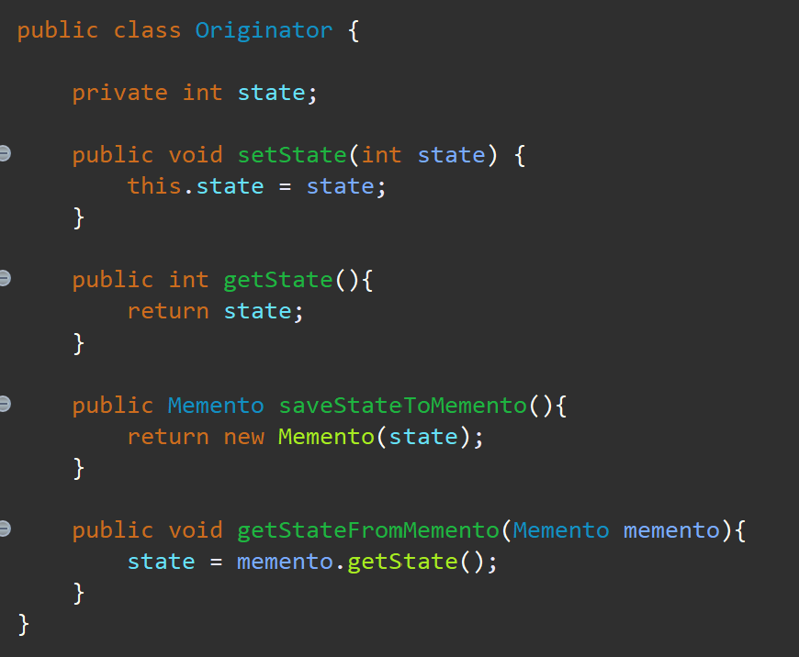
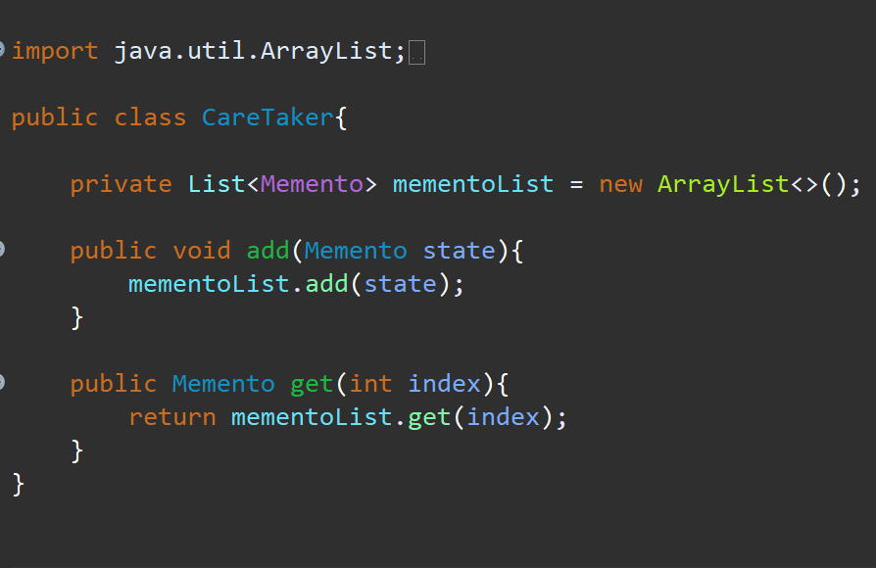
Originator Class Code
Caretaker Class Code
setState()
getState()
saveMemento()
getMemento()
add()
get()
Notes:
It is important to note that this entire memento code is implemented as to saveStates that are only ints because we are dealing with save numerical values on how much inventory is remaining/added to the warehouse.

Slide 7
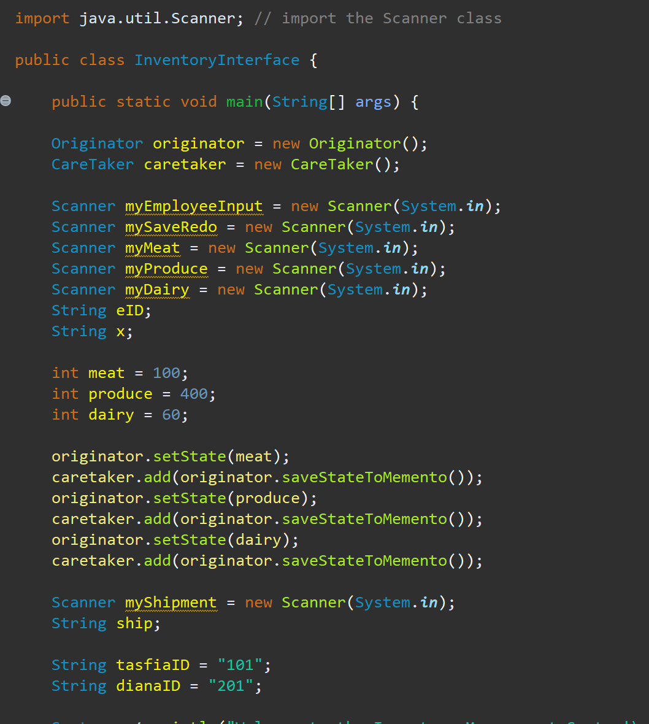
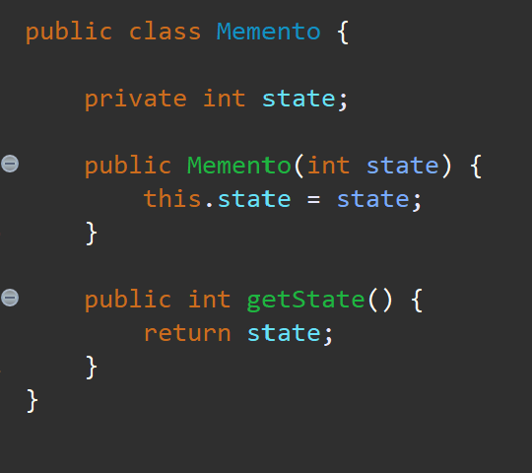
Inventory Interface Class Code
Memento Class Code
memento implementation #1
getState()

Slide 8
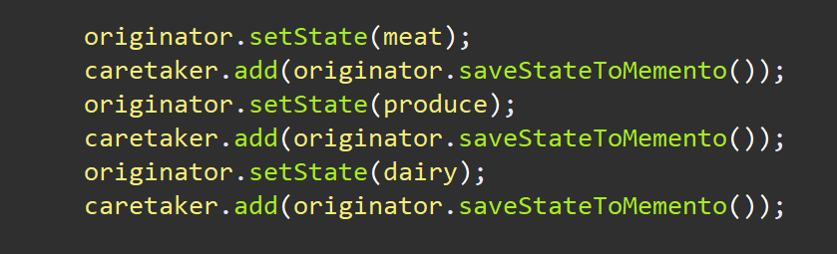
Inventory Interface Class Code (Deeper Look)
Saving the Original State
1) The originator will make sure the value of the object (meat, produce, dairy) is saved to a state → where the memento class will add it to an array/list (saving the value of 100, 400, 60)
2) The caretaker will act as a savepoint as it will serve to save these values into the actual arraylist so we can access it later when printing the index

Slide 9
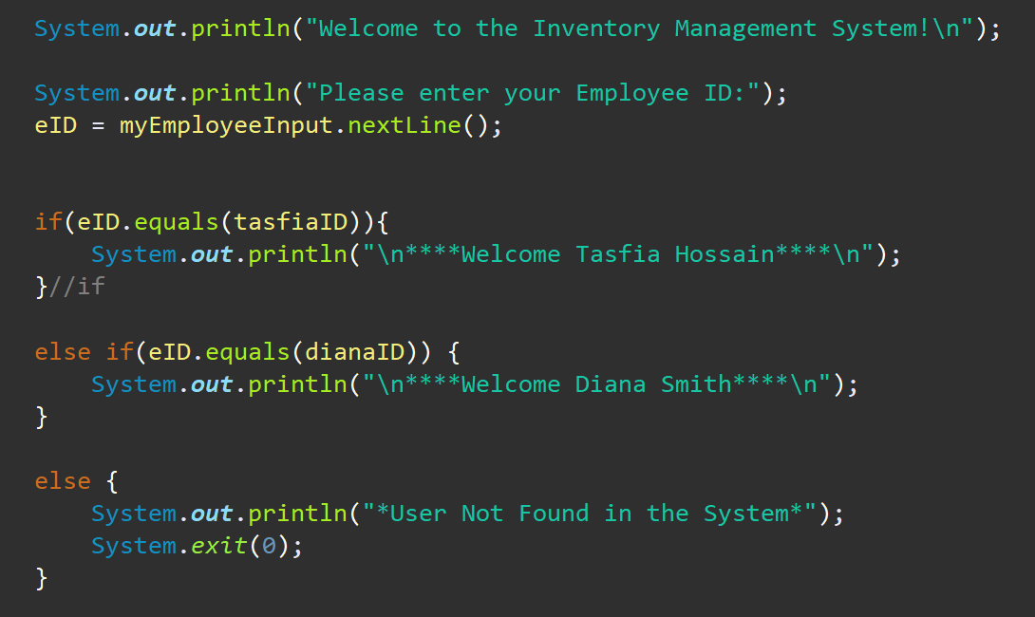
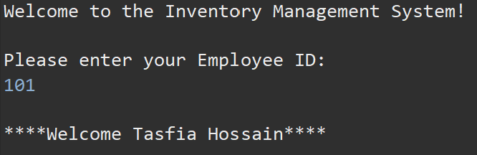
Inventory Interface Class Code (continued)
output
Notes:
Assuming all warehouse employees have an employee ID and can access the system using that ID, the user will be prompted to enter their ID and will be brought into the system, confirmed by their name displayed on the screen.

Slide 10
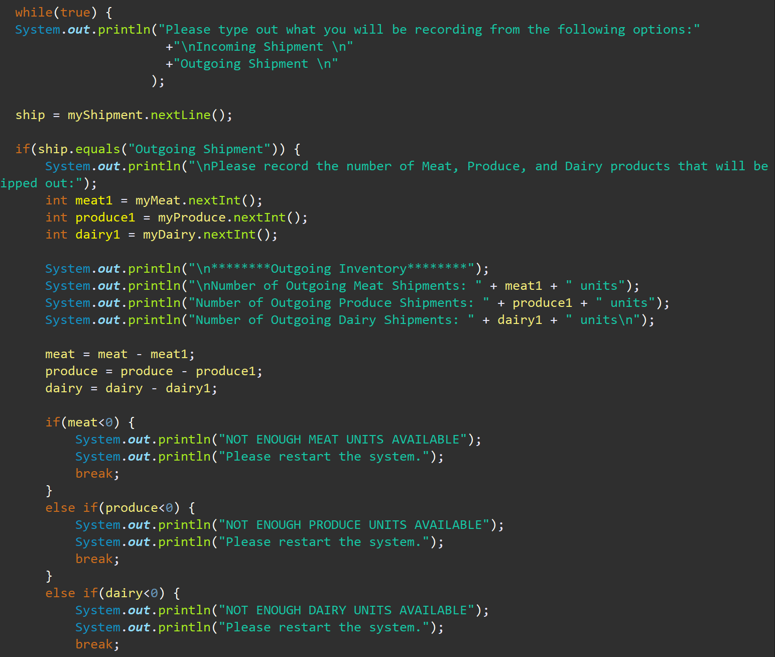
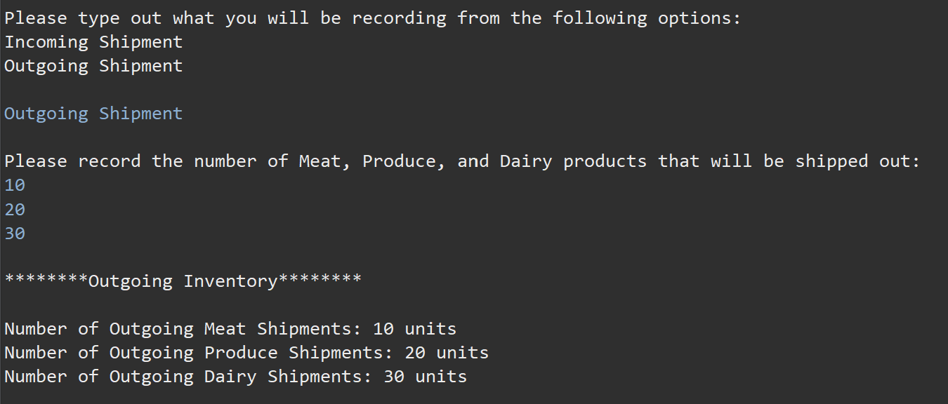
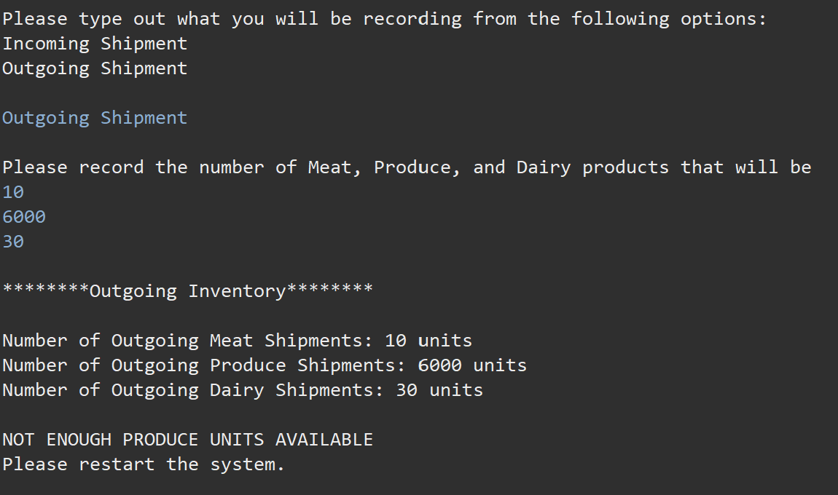
Inventory Interface Class Code (continued)
Output

Slide 11
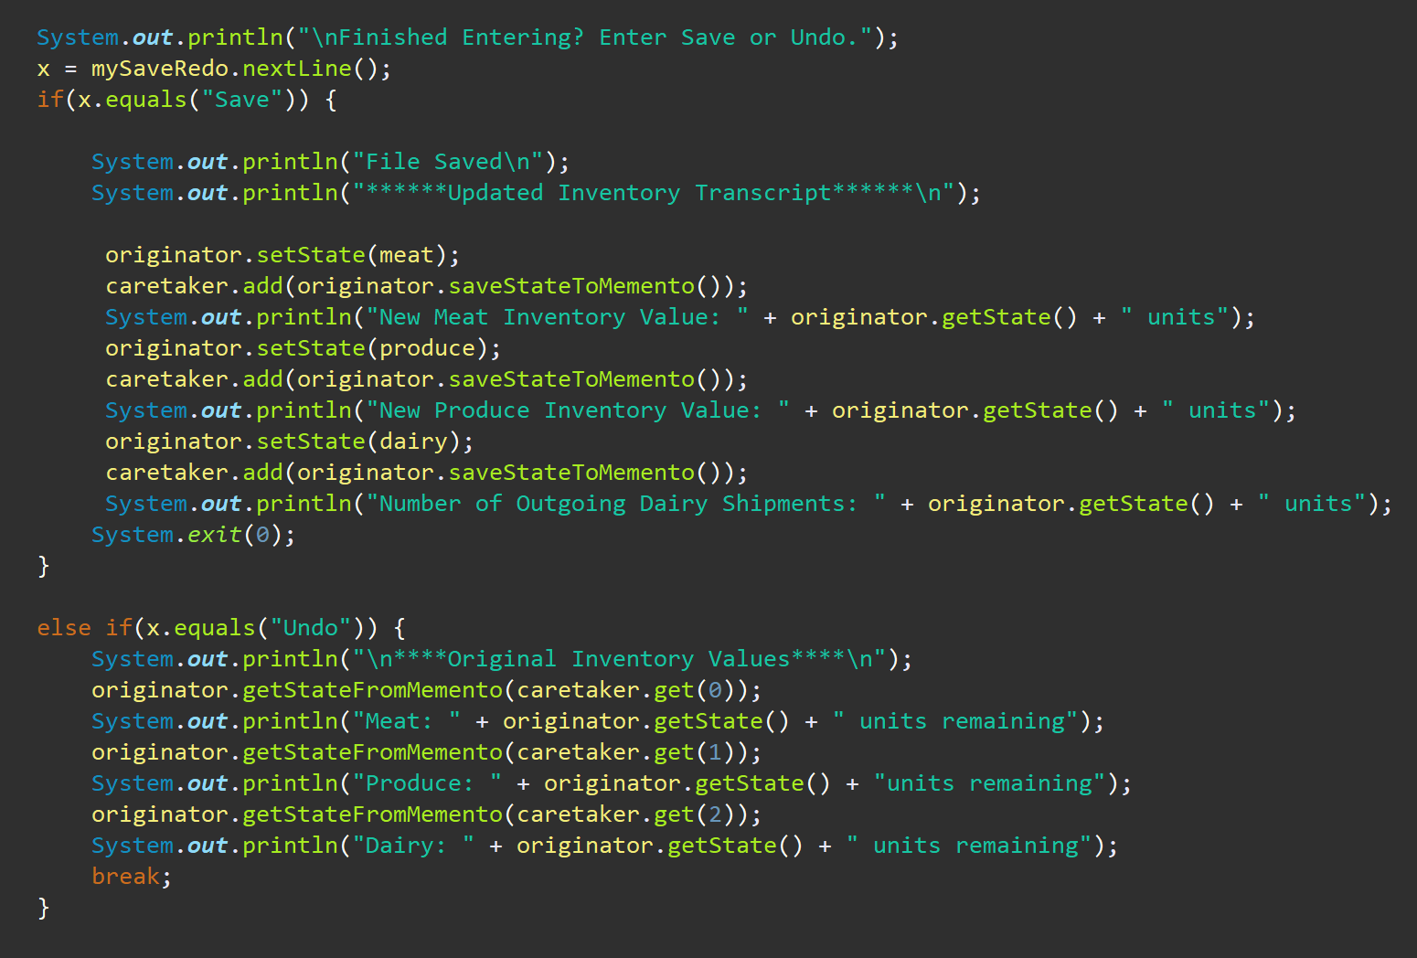
Inventory Interface Class Code (continued)
memento implementation #2
memento implementation #3

Slide 12
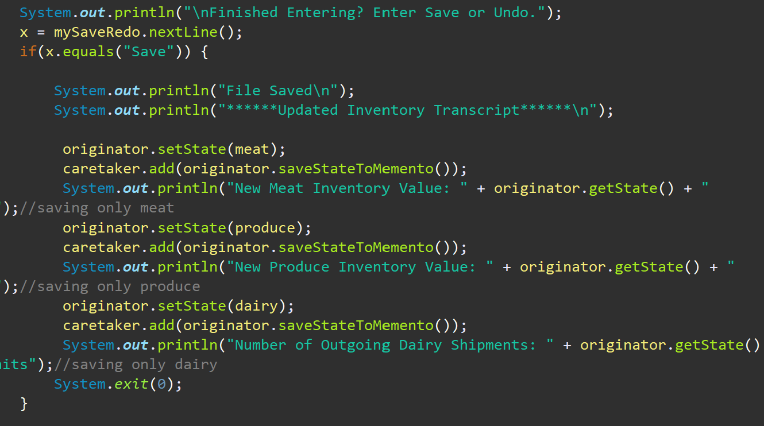
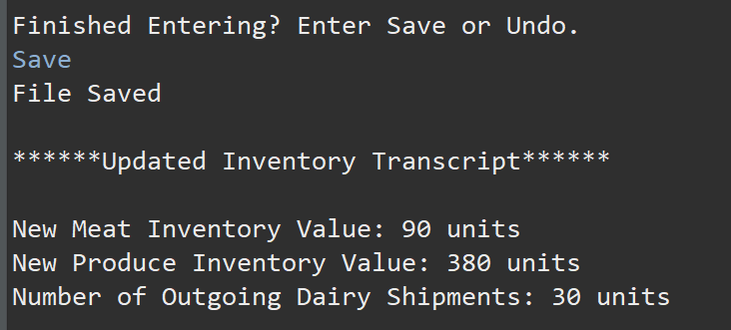
Deeper Look
Output
Employee finally has the option to save the values they inputted. When hitting save, the memento updates their save state to the new values operated values. The memento places those new values on the stack as they will now be the values to revert back in case another inventory sheet is put in.
Memento array will save these new values

Slide 13
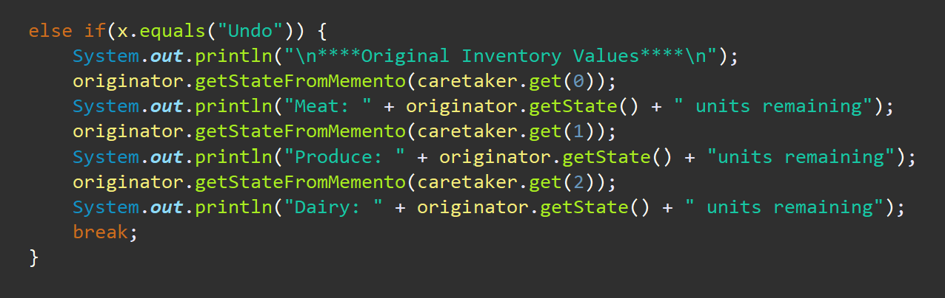
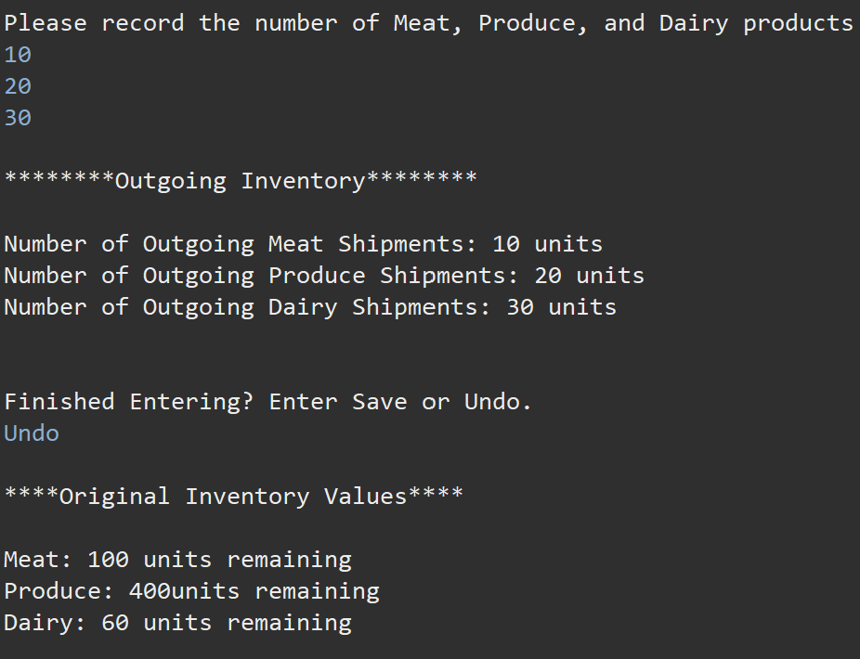
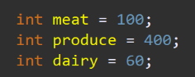
Deeper Look
Output
Employee realizes they made a mistake. They can use the undo feature. This will invoke the originator to get the state from the memento and return back the original value that was saved at index X of the array. In the case of index 0, we saved the original value of meat. With this being done, it will not take into account of the new values the state has saved (from the previous slide), but the values that were originally saved when we first did the memento implementation.
remember when we initialized this in the beginning?

Slide 14
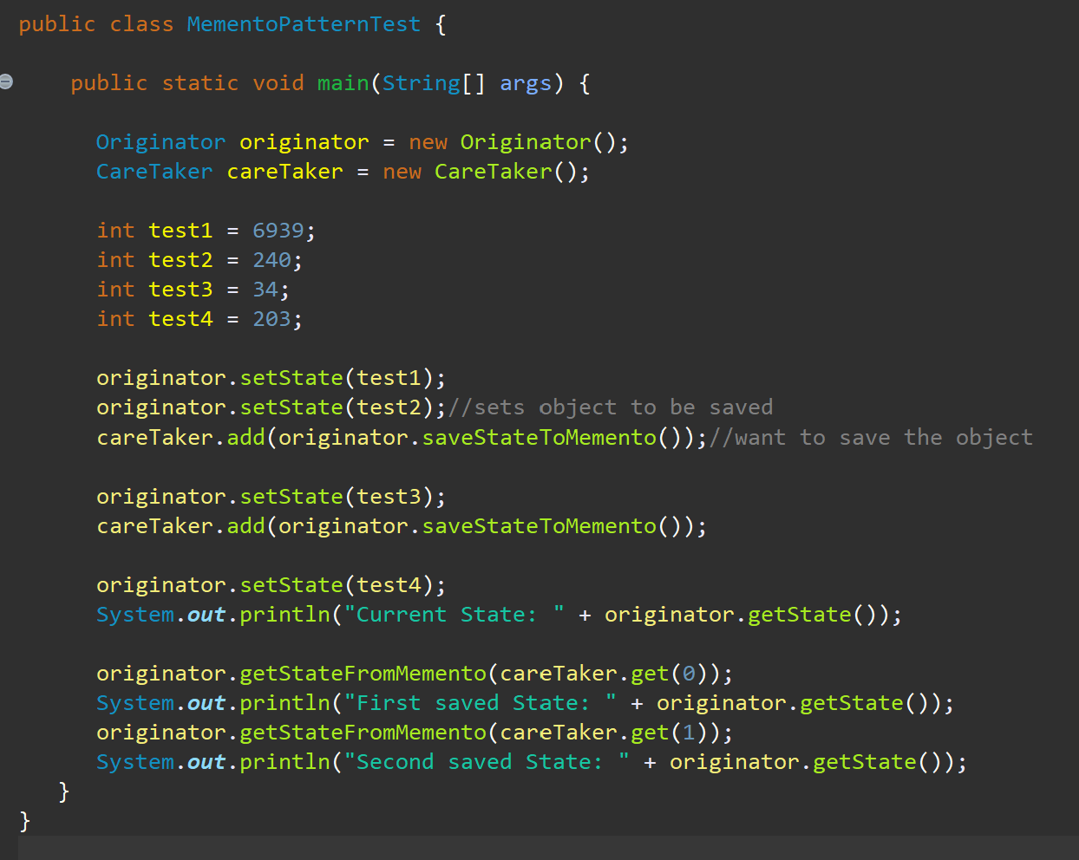
Unit Test

Slide 15
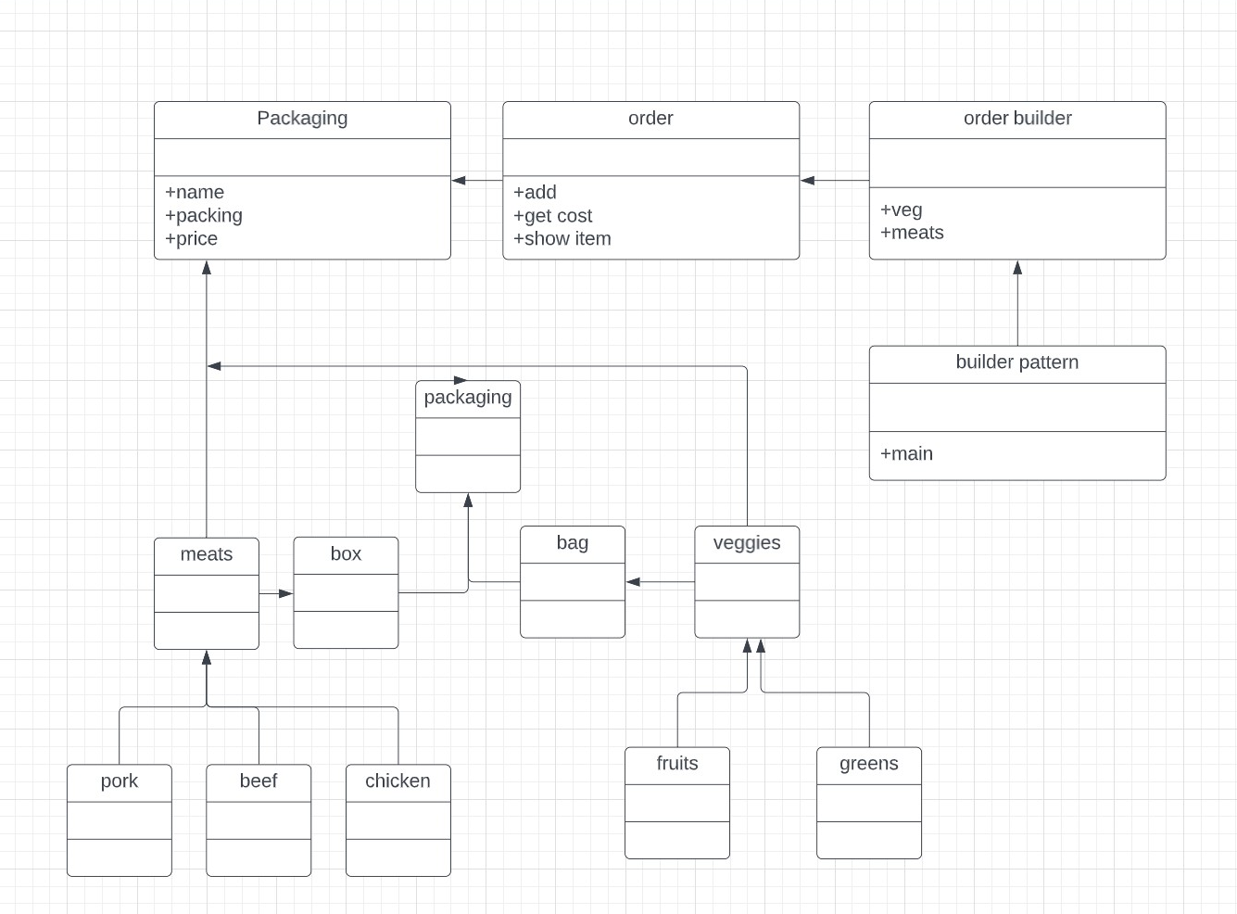
Builder Pattern
By: Yudava Roopnarine
Functionality
1) Builder pattern builds a complex object using simple objects and using a step by step approach. This type of design pattern comes under creational pattern as this pattern provides one of the best ways to create an object.
2) A Builder class builds the final object step by step. This builder is independent of other objects.

Slide 16
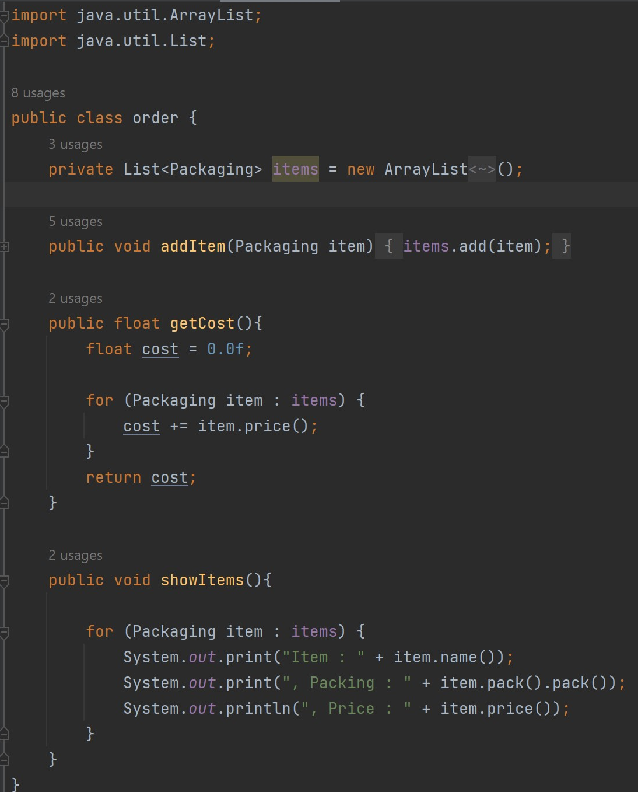
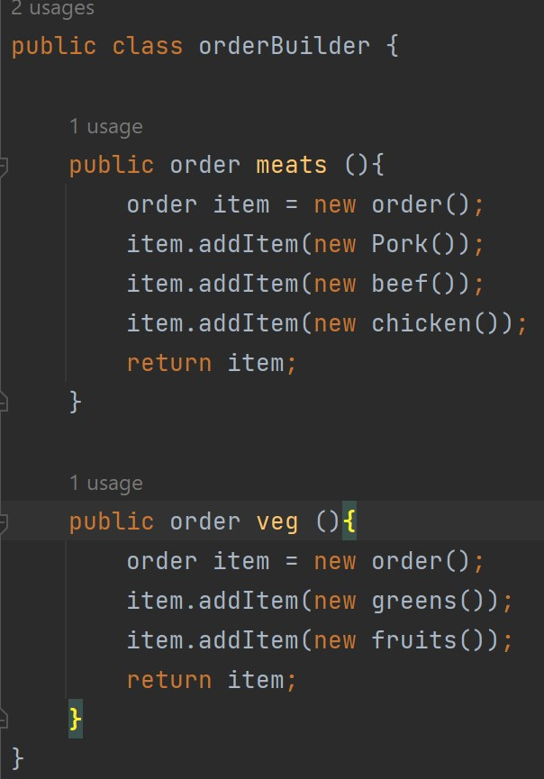
Code

Slide 17
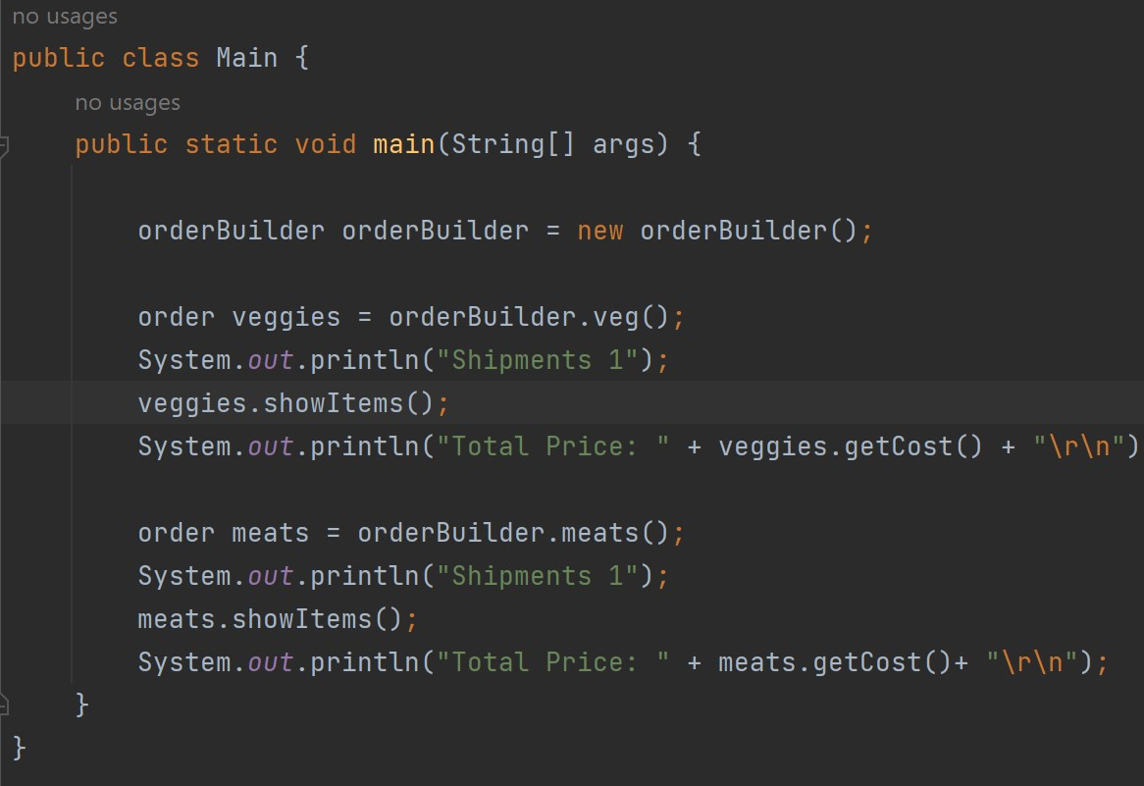
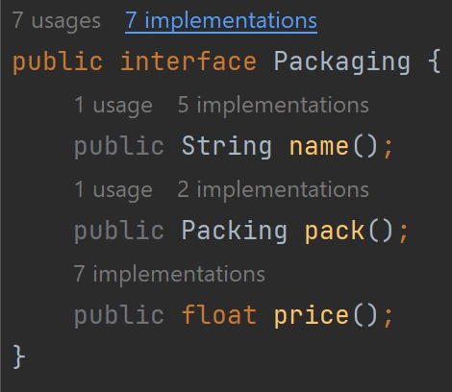

Slide 18
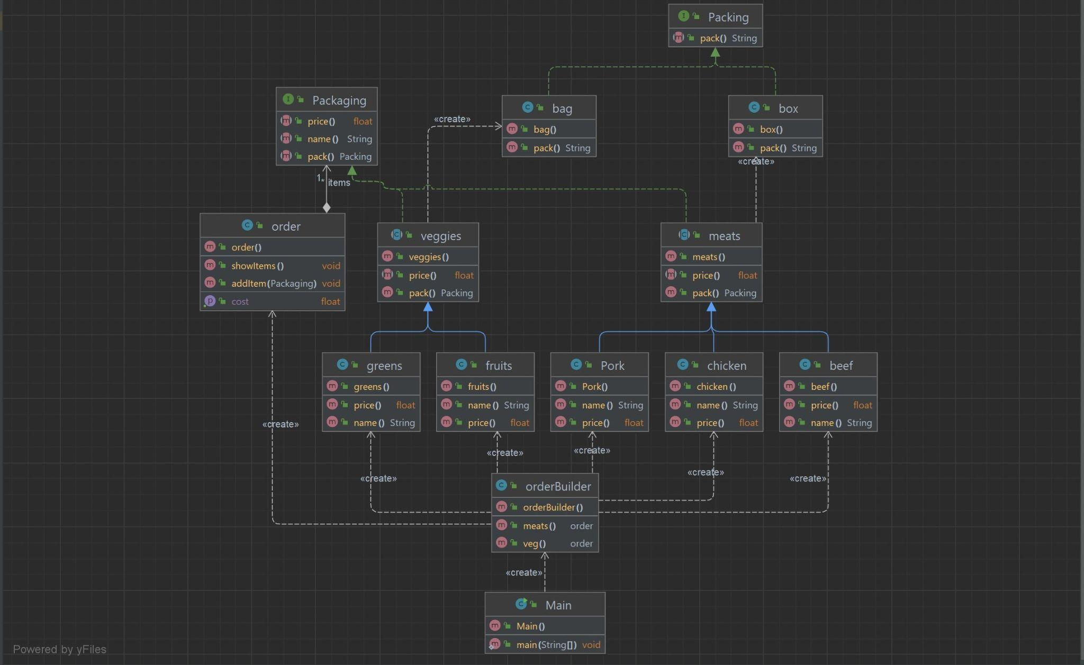
Builder Pattern UML

Slide 19
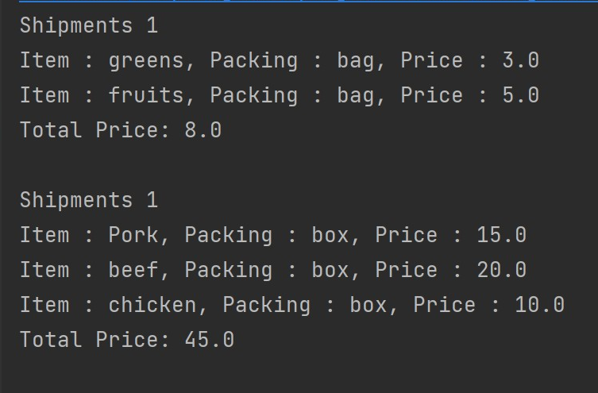
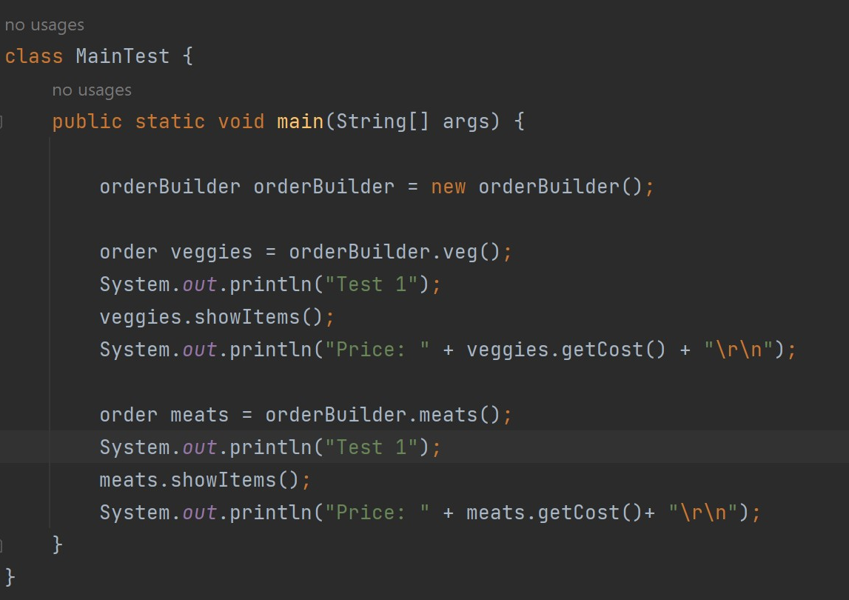
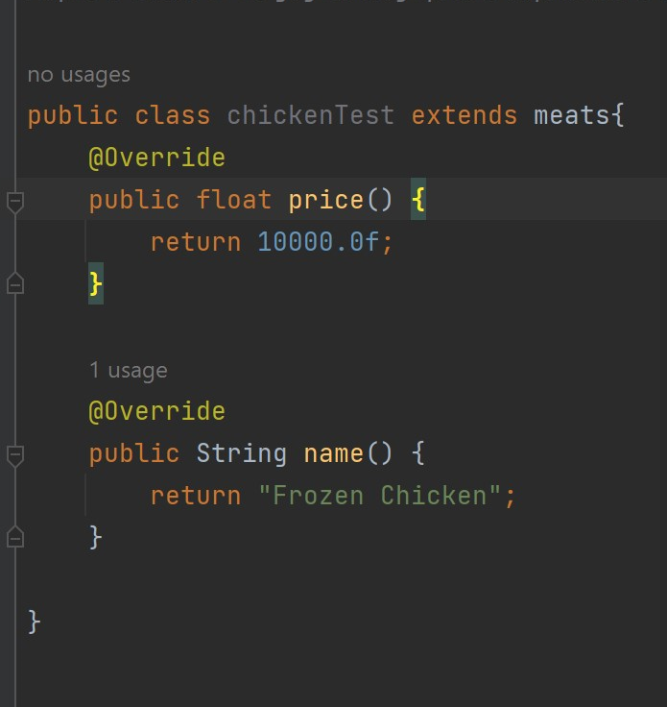
Code Output/Tests

Slide 20
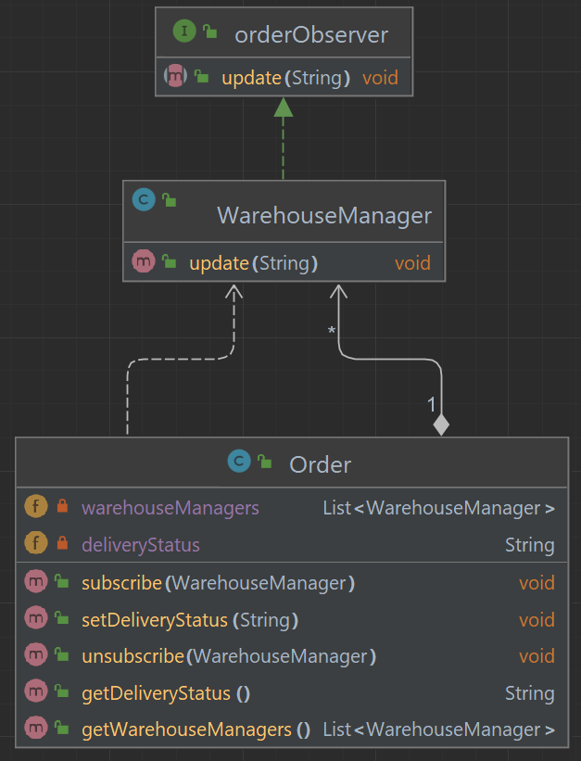
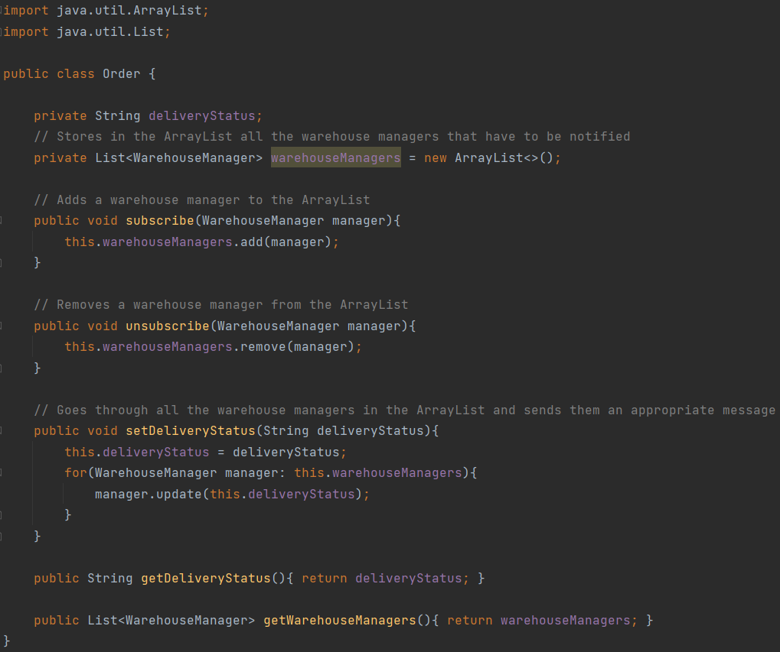

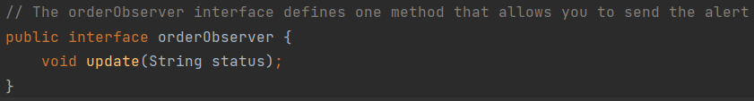
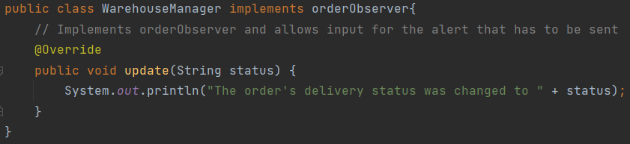
Observer Pattern
by Ivan Jimenez

Slide 21
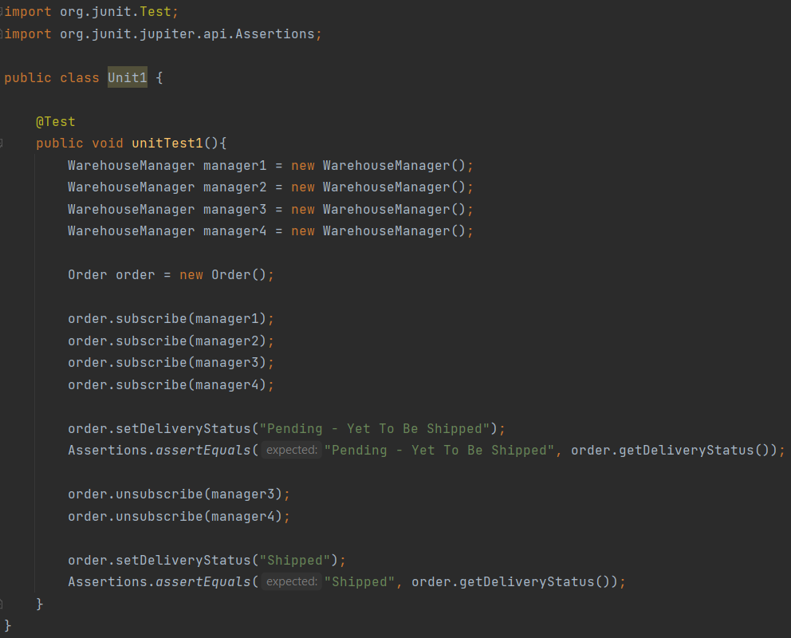
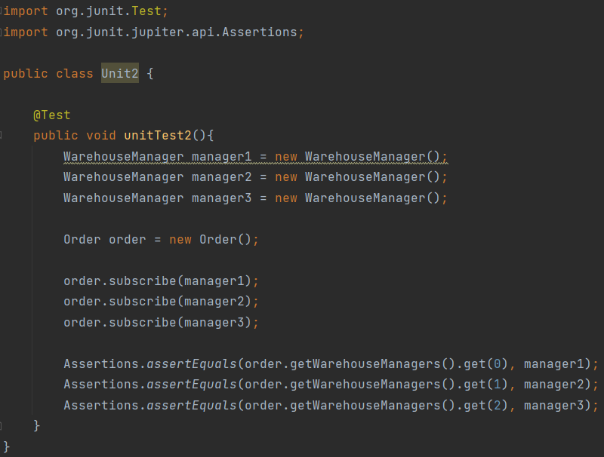
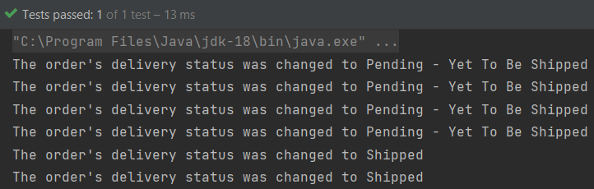
Observer Pattern Unit Tests
by Ivan Jimenez
Unit Test #1
Unit Test #2
Output →

Slide 22

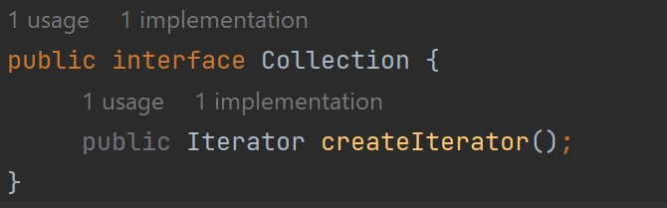
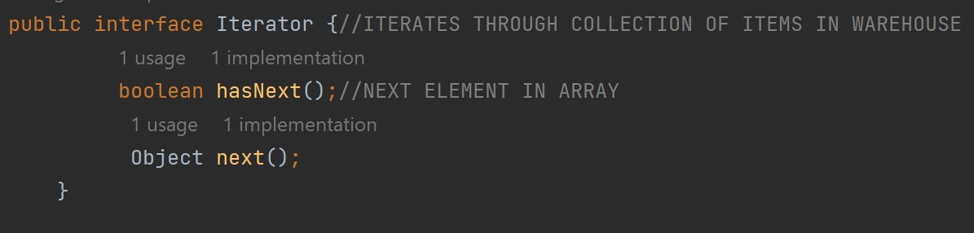
Iterator Pattern
By Rakib Rary
The iterator pattern allows us traverse elements of a collection without exposing its underlying representation(ex list, stack, tree,etc). For our warehouse inventory system we can iterate through the collection of items within our inventory.
The iterator pattern utilizes two interfaces the Iterator and Collection. The iterator interface is used to traverse through a collection, while the collection interface implements createIterator that returns iterator for its collection.

Slide 23

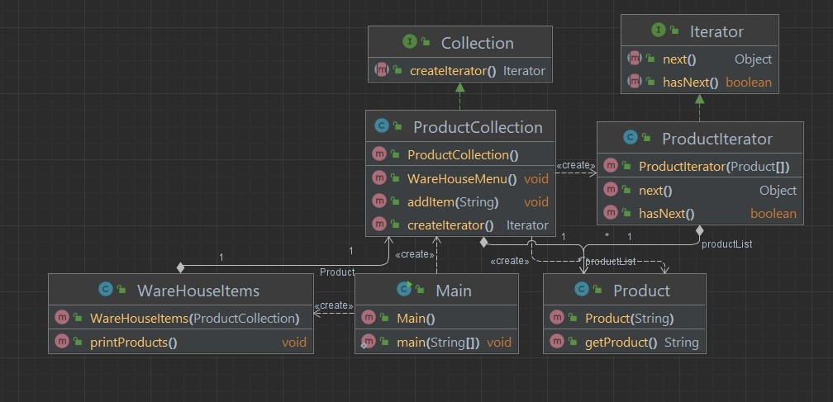
Iterator Pattern: UML
By Rakib Rary

Slide 24
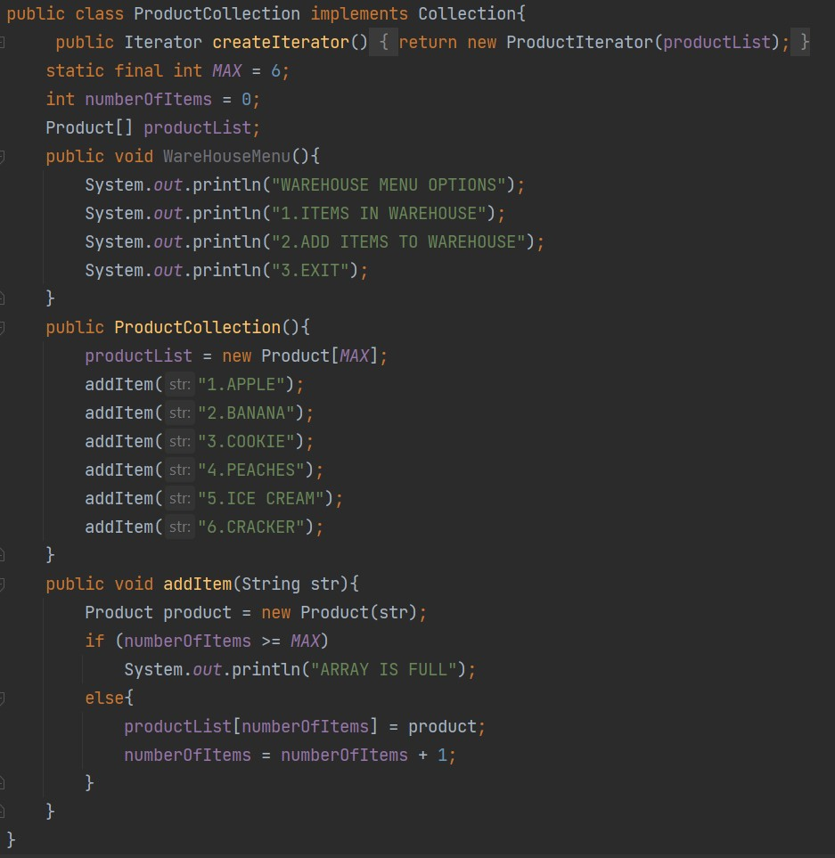
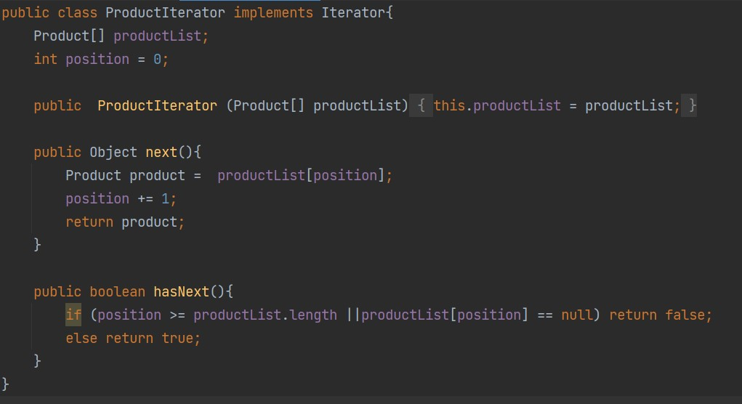
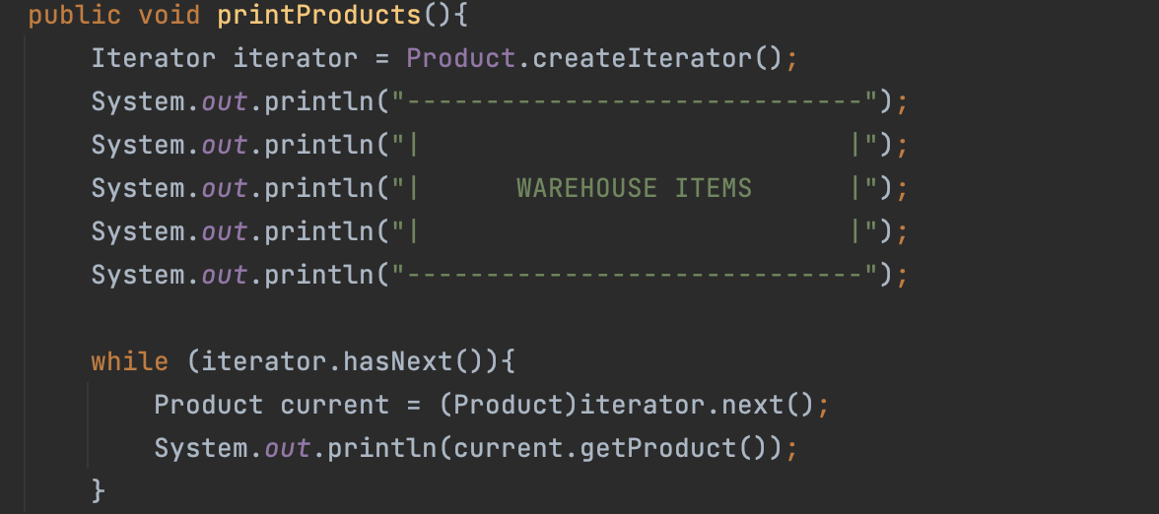
Iterator Pattern

Slide 25
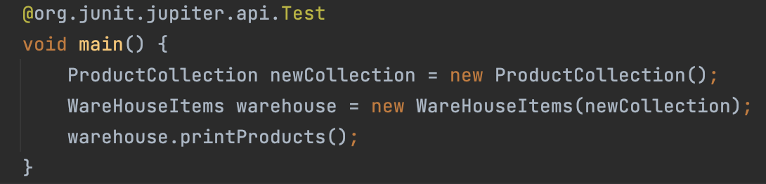
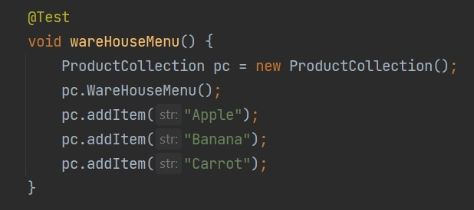
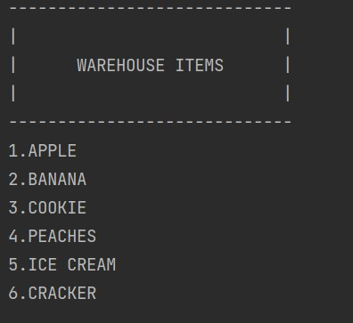
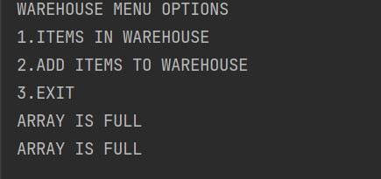
Unit Test

Slide 26

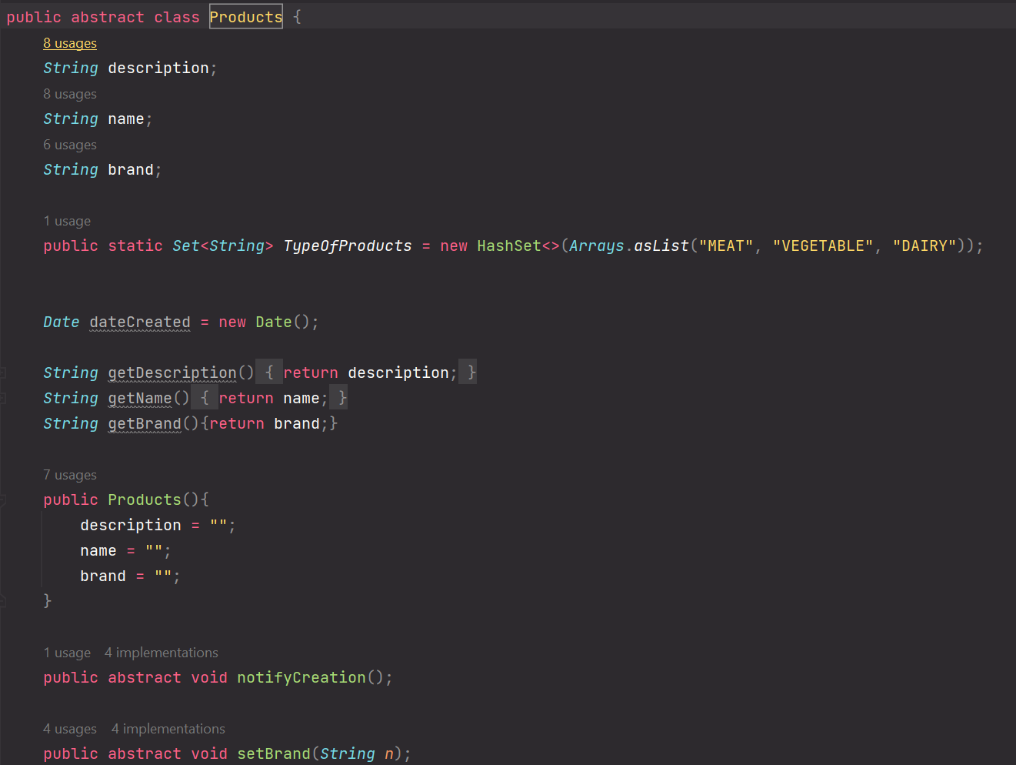
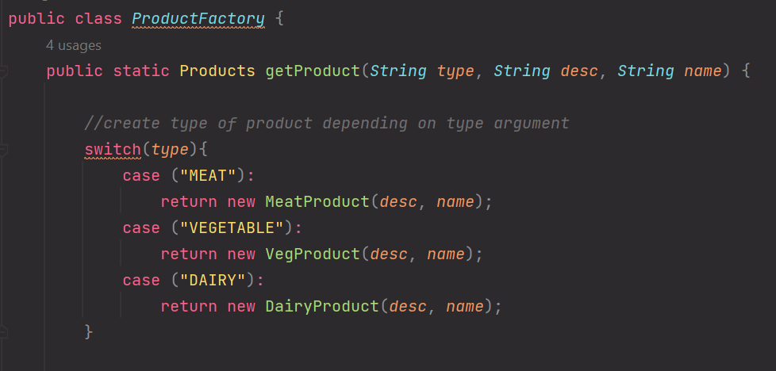
Factory Pattern
Matthew Murillo

Slide 27
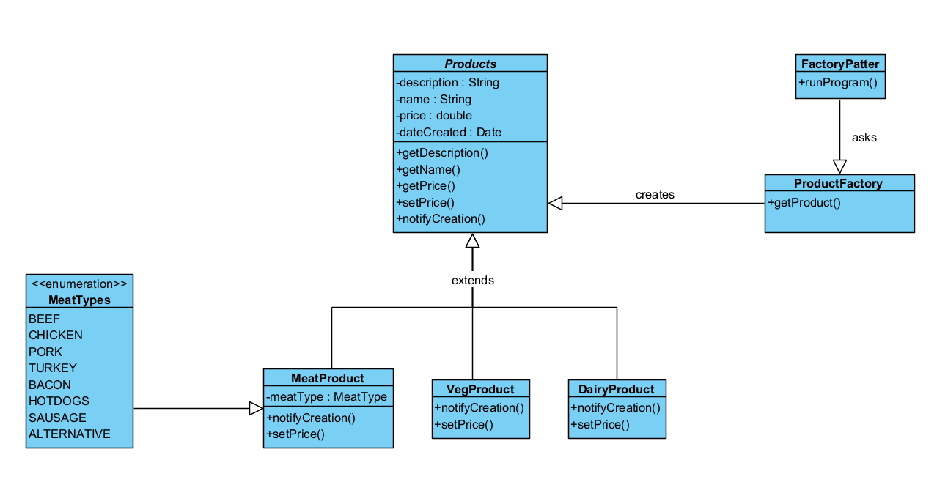
Factory Pattern: UML

Slide 28






Different Products
Meat
Vegetable
Dairy

Slide 29


Unit Tests

Slide 30


Strategy Pattern
Kevin Ren

Slide 31


Strategy Pattern

Slide 32










Slide 33



Unit Tests

Slide 34

End

